Slide 1
Big Mountain Ski Resort
Data-Based Guidance for Ticket Pricing and Facility Investment Planning

Slide 2
Problem Identification
How can Big Mountain Resort can adopt a data-driven pricing strategy that better reflects the value of its facilities?
We are aiming to maximize profitability while keeping ticket prices competitive with other resorts in the industry.

Slide 3
Recommendation and Key Findings
Big Mountain’s modelled price is $95.87, while its actual price is $81.00.
With this in mind, we recommend the following:
Increase the vertical drop by adding a run to a point 150 feet lower down.
This would require the installation of an additional chair lift to bring skiers back up.
Increase all ticket prices by $1.99.
Note that this would not require any additional snow-making coverage.

Slide 4
Modeling Results and Analysis
Big Mountain has many features that give it a competitive edge compared to other resorts, including…
large snowmaking area
high number of runs, fast quads, and total chairs
large amount of skiable terrain.
Our models suggest that resort visitors place high value on these amenities and are willing to pay a premium to use them.

Slide 5
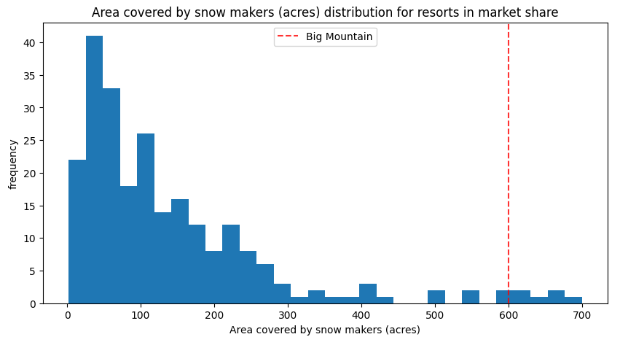
Modeling Results and Analysis Large snowmaking area

Slide 6
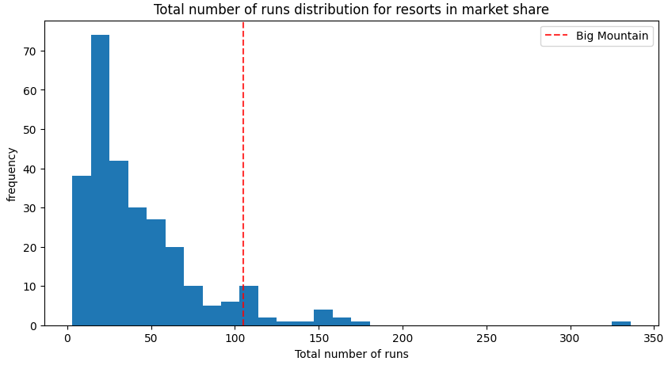
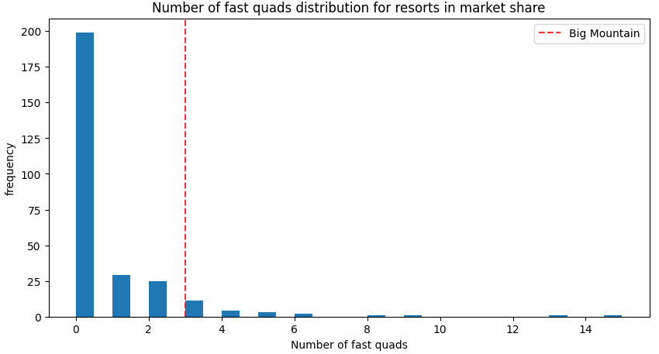
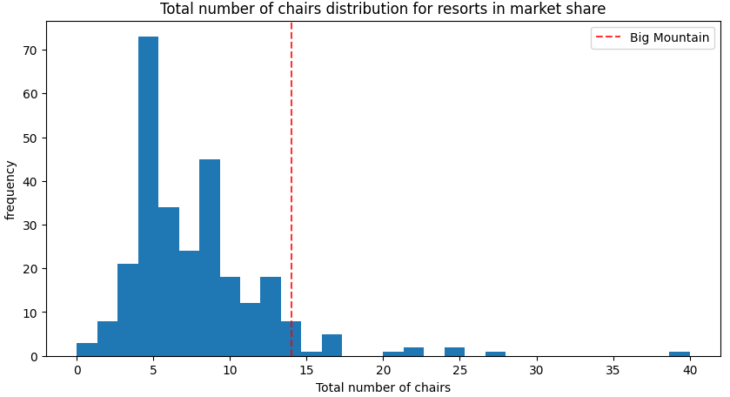
Modeling Results and Analysis High number of runs, fast quads, and total chairs

Slide 7
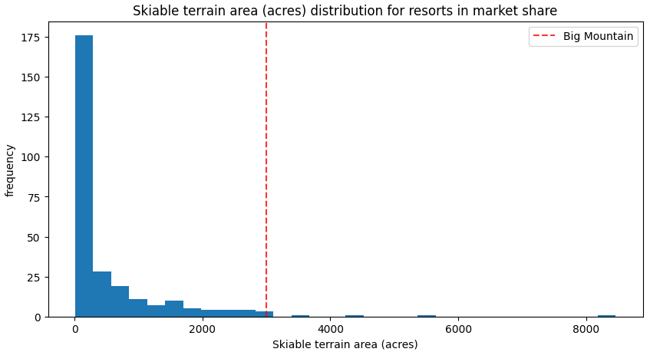
Modeling Results and Analysis Large amount of skiable terrain

Slide 8
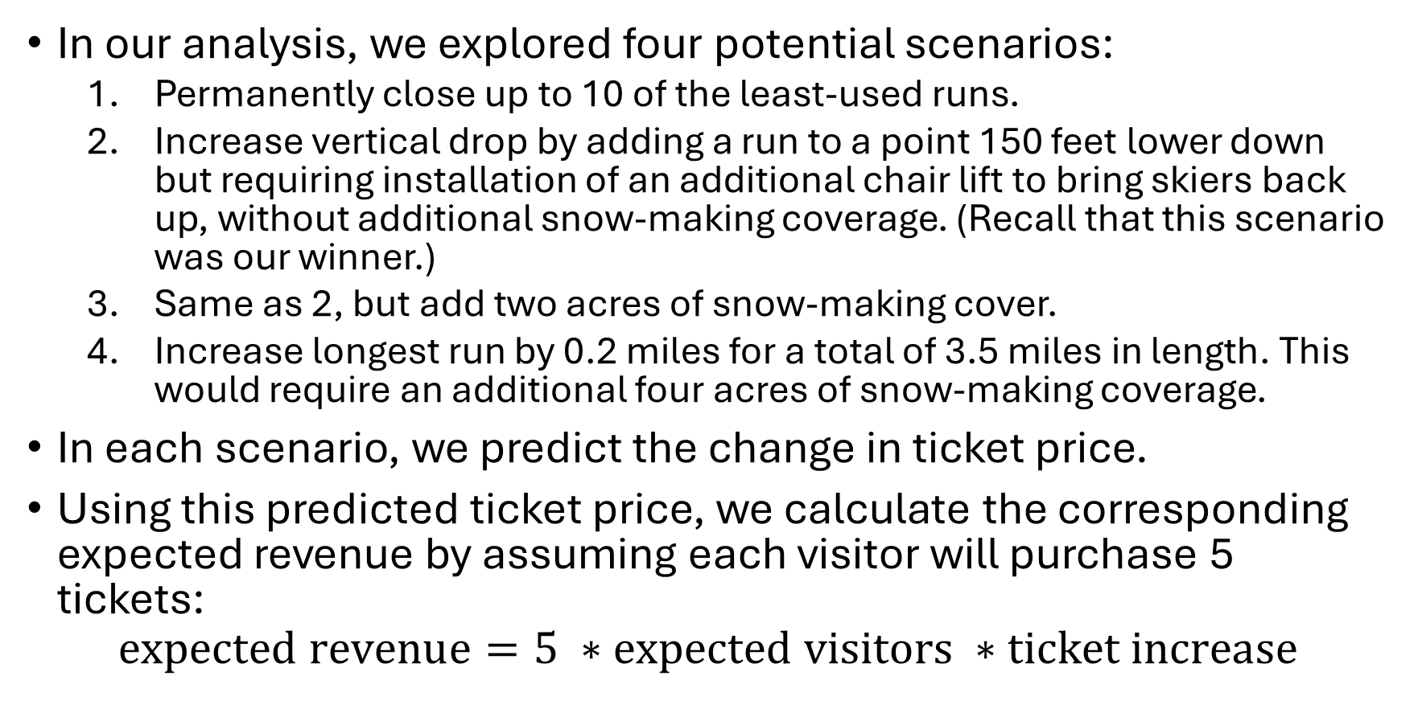
Modeling Results and Analysis
In our analysis, we explored four potential scenarios:
Permanently close up to 10 of the least-used runs.
Increase vertical drop by adding a run to a point 150 feet lower down but requiring installation of an additional chair lift to bring skiers back up, without additional snow-making coverage. (Recall that this scenario was our winner.)
Same as 2, but add two acres of snow-making cover.
Increase longest run by 0.2 miles for a total of 3.5 miles in length. This would require an additional four acres of snow-making coverage.
In each scenario, we predict the change in ticket price.
Using this predicted ticket price, we calculate the corresponding expected revenue by assuming each visitor will purchase 5 tickets:
$$expected revenue=5 ∗expected visitors ∗ticket increase$$

Slide 9
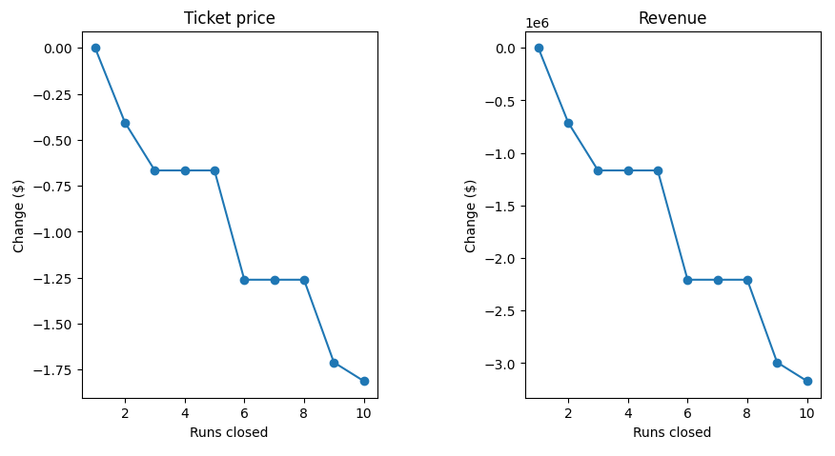
Modeling Results and Analysis Scenario 1: Permanently close up to 10 of the least-used runs.
Left: Change in ticket price vs. number of runs closed
Right: Change in revenue vs. number of runs closed
Ticket price, and subsequently revenue, either drops or stays constant with each successive run closure.
We advise against closing any runs, as it would have no positive effect on revenue.

Slide 10
Modeling Results and Analysis Scenario 2: Increase vertical drop by adding a run to a point 150 feet lower down but requiring installation of an additional chair lift to bring skiers back up, without additional snow-making coverage.
In this scenario, we used our machine learning model to predict how adding a run and increasing the vertical drop by 150 feet would affect ticket price.
Additionally, since adding a run would require the installation of an extra chair lift, we accounted for this additional chair lift in our model as well.
This scenario supports an increase in ticket price by $1.99.
Over the season, revenue could be expected to amount to $3,474,638.

Slide 11
Modeling Results and Analysis Scenario 3: Same as 2, but add two acres of snow-making cover.
Since this is the same as scenario 2, we simply took the additional 2 acres of snow-making into account in our price prediction model.
Under these conditions, our model supports a ticket price increase of $1.99, amounting to a total revenue of $3,474,638.
This prediction is exactly the same as it was in scenario 2, so adding an additional 2 acres of snow-making area would make no difference.

Slide 12
Modeling Results and Analysis Scenario 4: Increase longest run by 0.2 miles for a total of 3.5 miles in length. This would require an additional four acres of snow-making coverage.
In our final scenario, we used our model to predict how increasing the longest run by 0.2 miles and adding an additional 4 acres of snow-making coverage would affect ticket price.
Our model predicted an increase of $0… Why?
Our model suggests that visitors do not value “longest runs” as highly as they do other amenities, such as vertical drops, total chairs, and fast runs.

Slide 13
Summary and Conclusion
Our analysis supports the following scenario:
Increase the vertical drop by adding a run to a point 150 feet lower down, but requiring the installation of an additional chair lift to bring skiers back up, without additional snow-making coverage.
Our analysis suggests that doing this would result in a revenue increase of $3,474,638 over the season.
This would also require a ticket price increase of $1.99.

